Slide 1
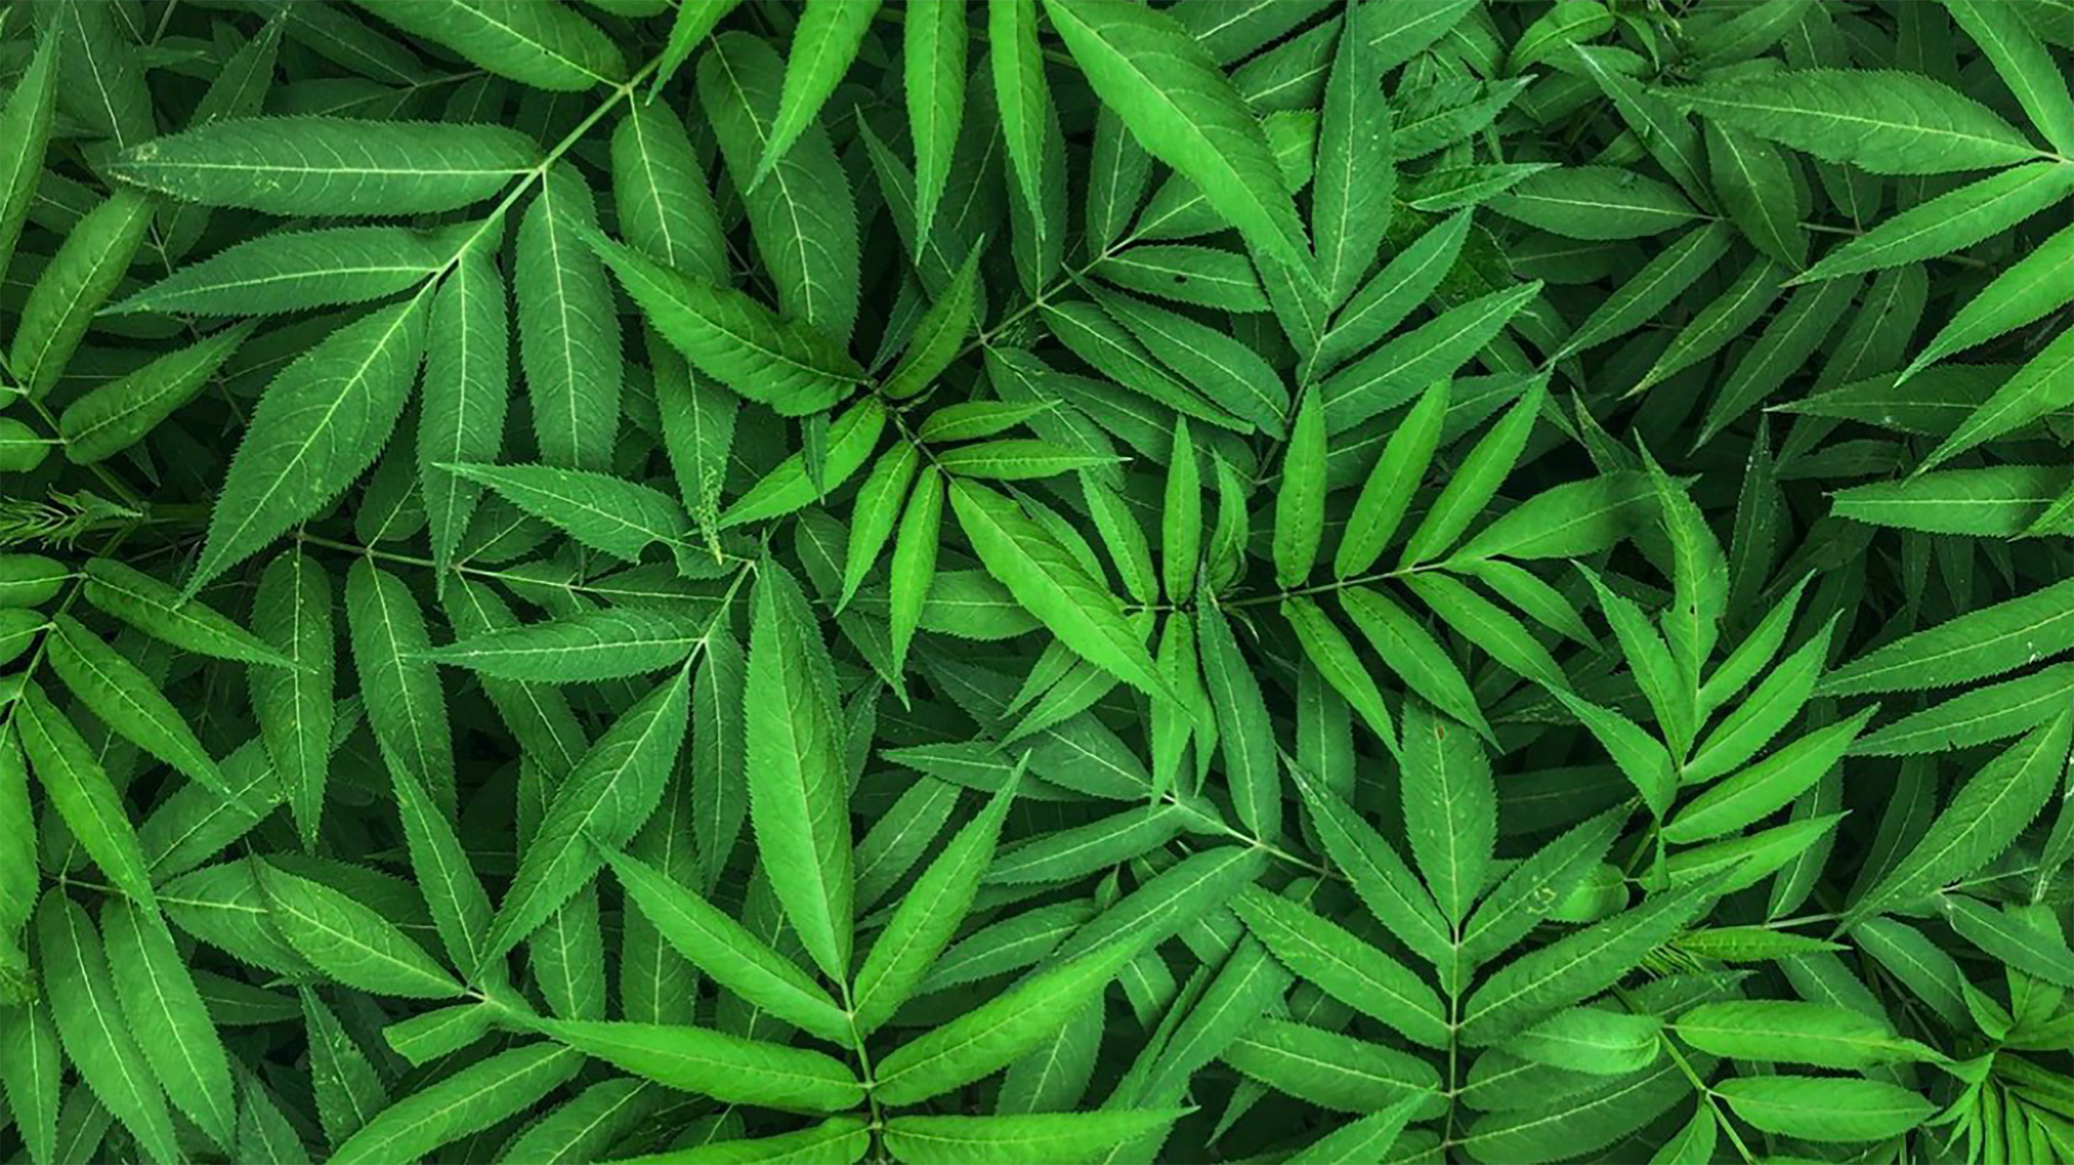

Slide 2
VietTree Guru
Plant Identification & Quiz Generation

Slide 3
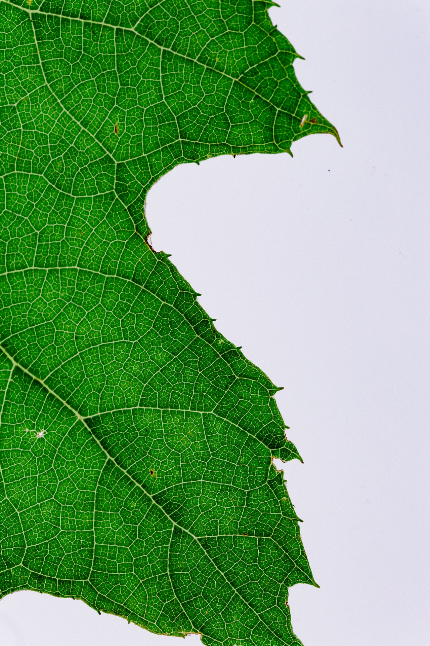




The idea
A plant-identification app tailor-made for the Vietnamese ecosystem
Informative content from Wikipedia to enrich your knowledge
Interactive Quiz for a fun learning experience
Notes:
Trees are vital: they give us oxygen, store carbon, stabilize the soil, and give life to the world’s wildlife. That’s where I got the idea of creating a plant-identification tool: VietreeGuru. Reasons for recognizing and knowing more about trees and plants are countless, going from professional reasons to plain curiosity; arborists, landscape architects, foresters, biology students, environment experts, farmers… or simply nature enthusiasts: these are the people VietreeGuru is made for.
Obviously VietreeGuru is not the first plant-identification tool in the market, but not many plant identifiers are built to recognize trees typical of the Vietnamese ecosystem; scope of VietreeGuru is to fill in this gap, and, furthermore, provide insightful information, and create fun learning experience. After identifying the plant, VietreeGuru returns general information about the classified tree, with a link to a webpage for more detailed specifications, and generates a 10-question quiz to test user’s expertise on the subject.
Identification, information, testing: enjoy VietreeGuru!

Slide 4
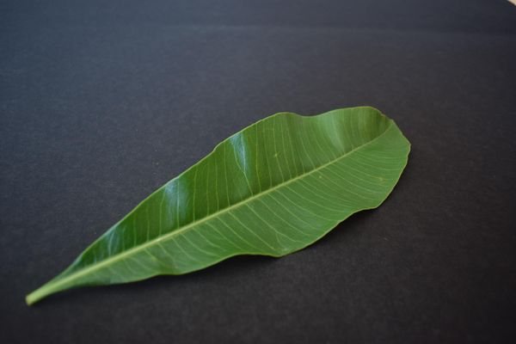
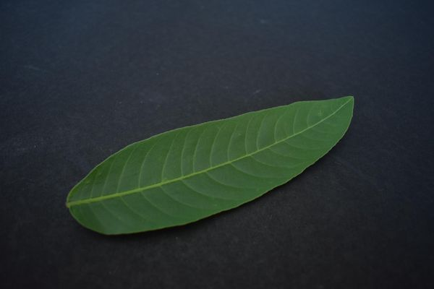
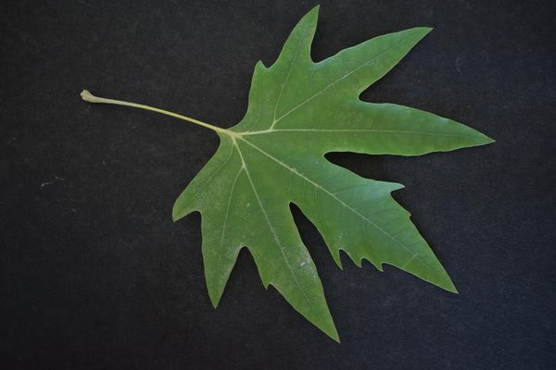
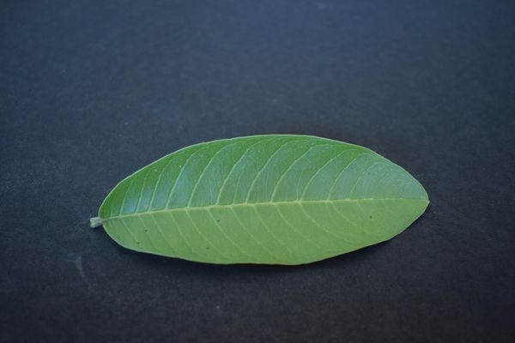
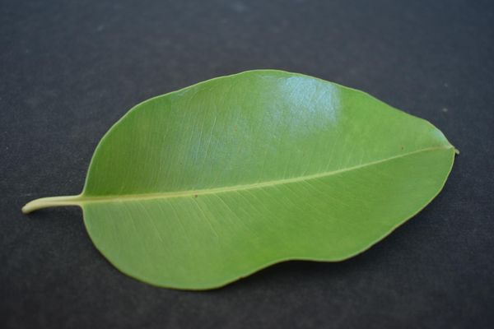
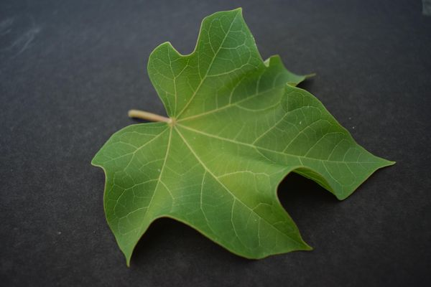
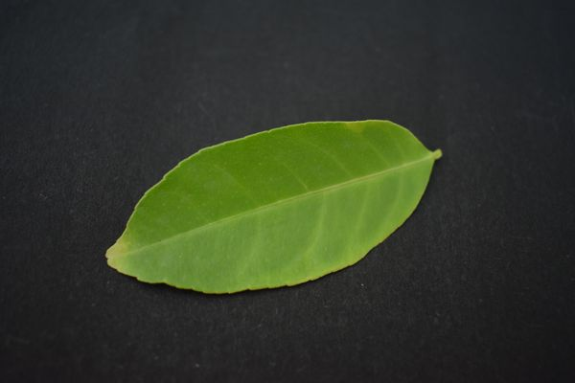
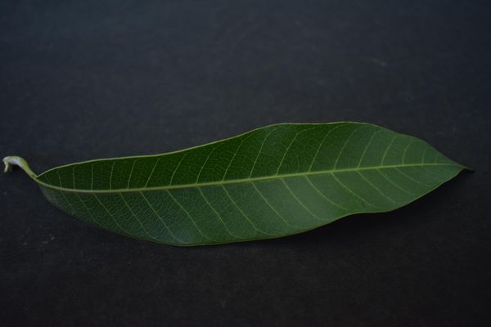
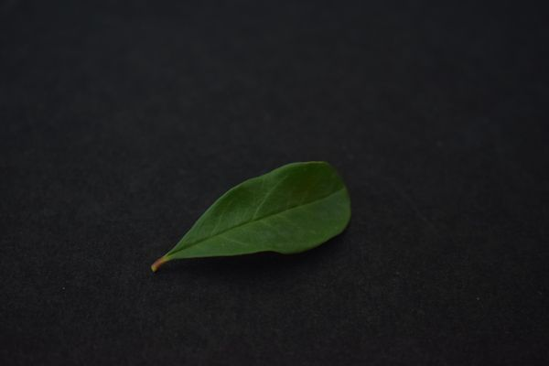
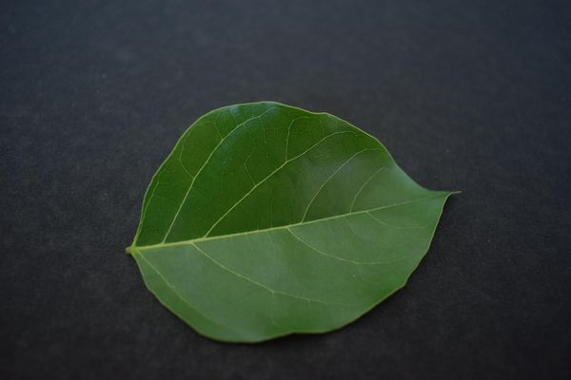
The Dataset
The Dataset
Alstonia scholaris
Arjun
Chinar
Guava
Jamun
Leaf Indetification
Quiz Generation
Jatropha
Lemon
Mango
Pomegranate
Pongamia Pinnata
Web-app Demo
Future work

Slide 5
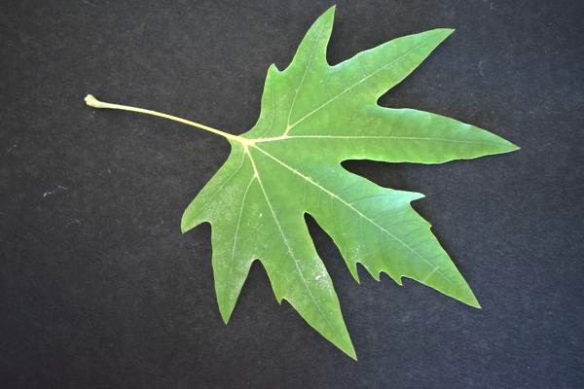
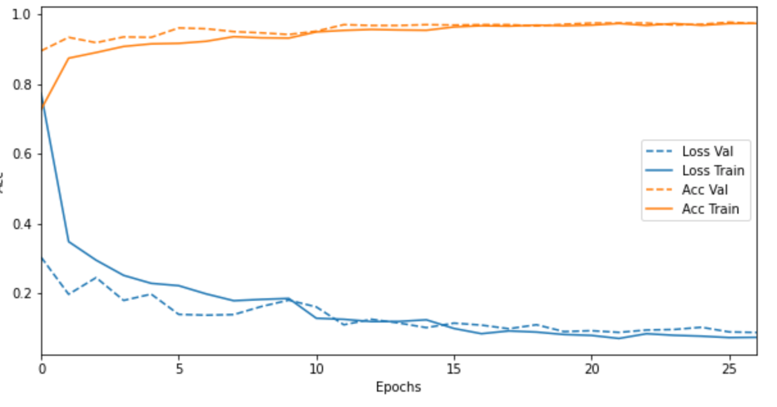
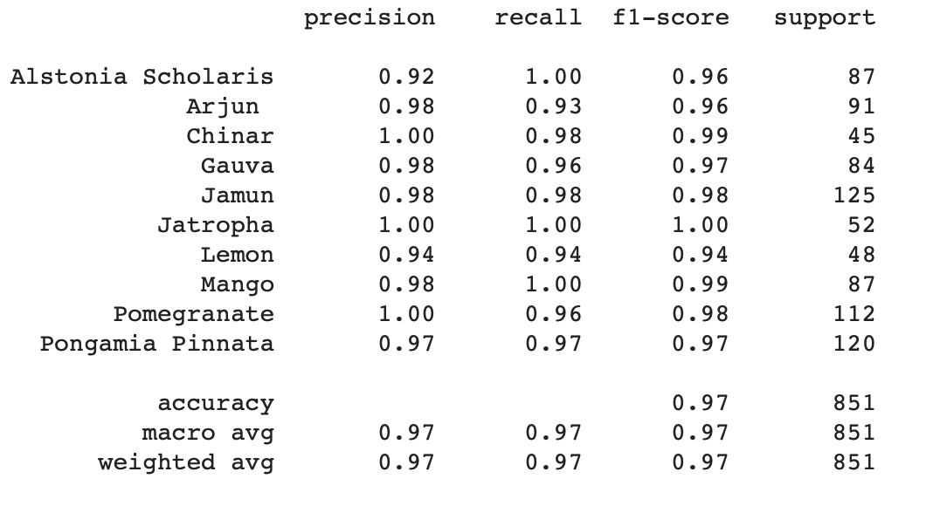
Leaf Identification
The Dataset
Rescale
Rotation, shift
Shear, zoom, flip
Brightness Adj.
Block 16
Block 17
1x1 Convo
Global Avg. Pool
FC + Relu + DO
FC + Relu + DO
FC + Softmax
...
Prediction
(label)
Leaf Indetification
Input: RGB color
Preprocessing
MobileNet V2 Base
Classifier Head
Quiz Generation
Web-app Demo
Future work

Slide 6


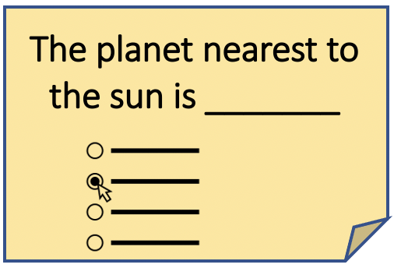
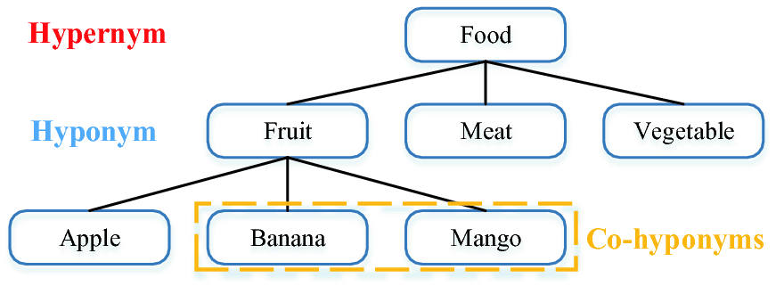
Quiz Generation
Wikipedia Article
WordNet
The Dataset
Example:
ConceptNet
Or any other text
Leaf Indetification
Input: text file
Key Phrase Extraction
Distractor Generation
Output: Cloze Questions
Quiz Generation
1. Plain text
Worldwide, there are several hundred cultivars of mango. Depending on the cultivar, mango fruit varies in size, shape, sweetness, skin color, and flesh color which may be pale yellow, gold, or orange.
2. Identify key phrases
Worldwide, there are several hundred cultivars of mango. Depending on the cultivar, mango fruit varies in size, shape, sweetness, skin color, and flesh color which may be pale yellow, gold, or orange.
3. Generate Distractors
Key words: sweetness
Distractor: bitterness, palatability, rancidness, sourness', spiciness, unpalatability
4. Generate Quiz
Depending on the cultivar, mango fruit varies in size, shape, ____________, skin color, and flesh color which may be pale yellow, gold, or orange.
A: bitterness B: sweetness
C: rancidness D: sourness
Web-app Demo
Future work

Slide 7
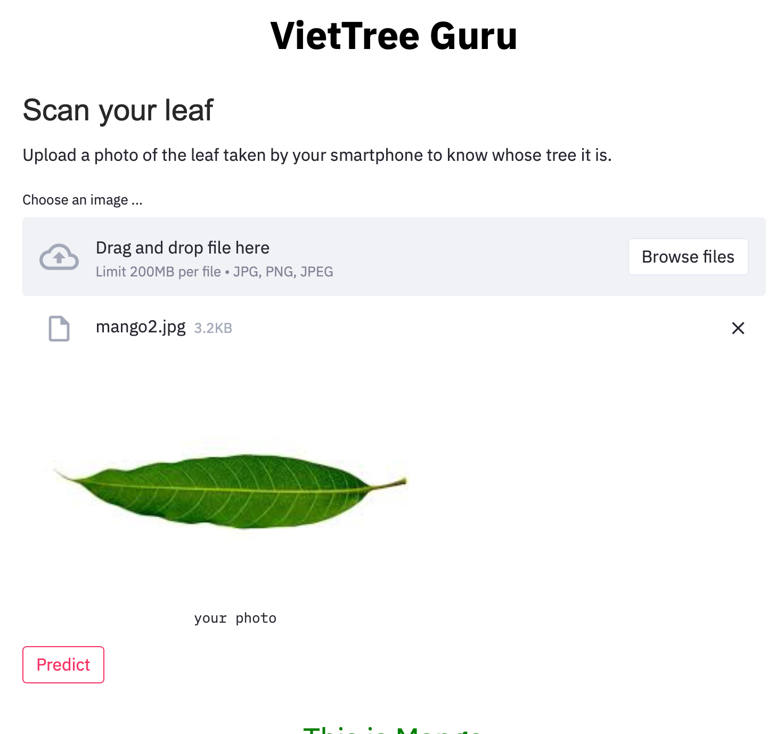
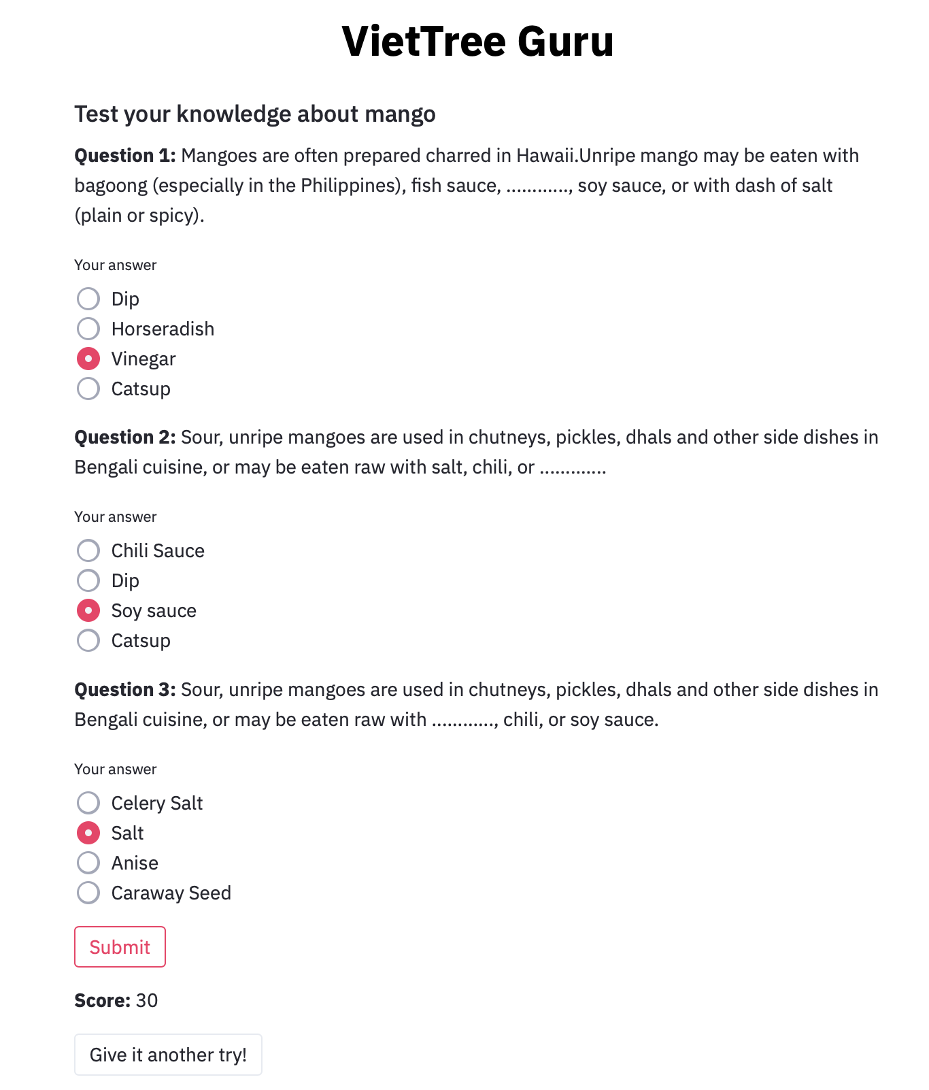

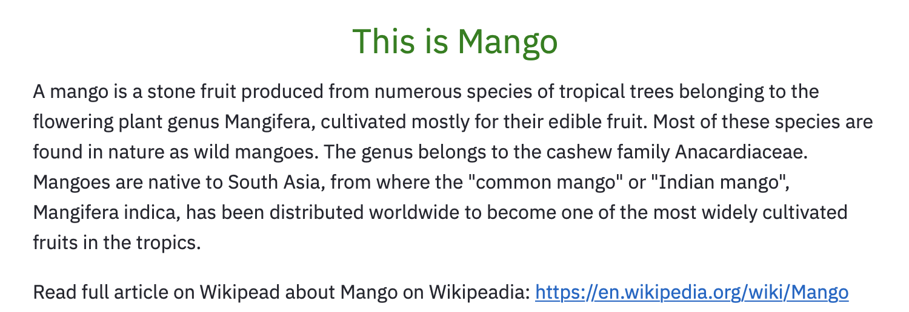
Web-app Demo
The Dataset
Leaf Indetification
Quiz Generation
Web-app Demo
Future work

Slide 8

Future Work
The Dataset
Collect more data, especially field photos
Improve pressossing with state-of-the-art techineques
Plant Identification
Plant Indetification
Quiz Generation
Include text summarization for long text or articles
Explore sequence-to-sequence technique for question-answer generation
Quiz Generation
Web-app Demo
Future Work

Slide 9
Thank you
Presented by Thinh Cao

Slide 10



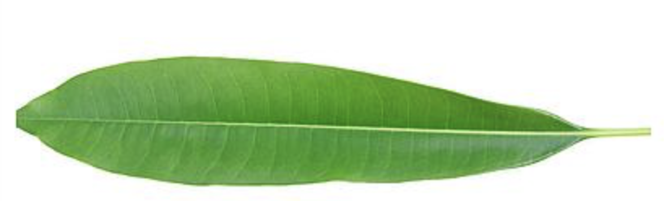


The planet nearest to the sun is _______
“One touch of nature makes the whole world kin.”
ietTree Guru
Plant Identification & Quiz Generation

